Slide 1
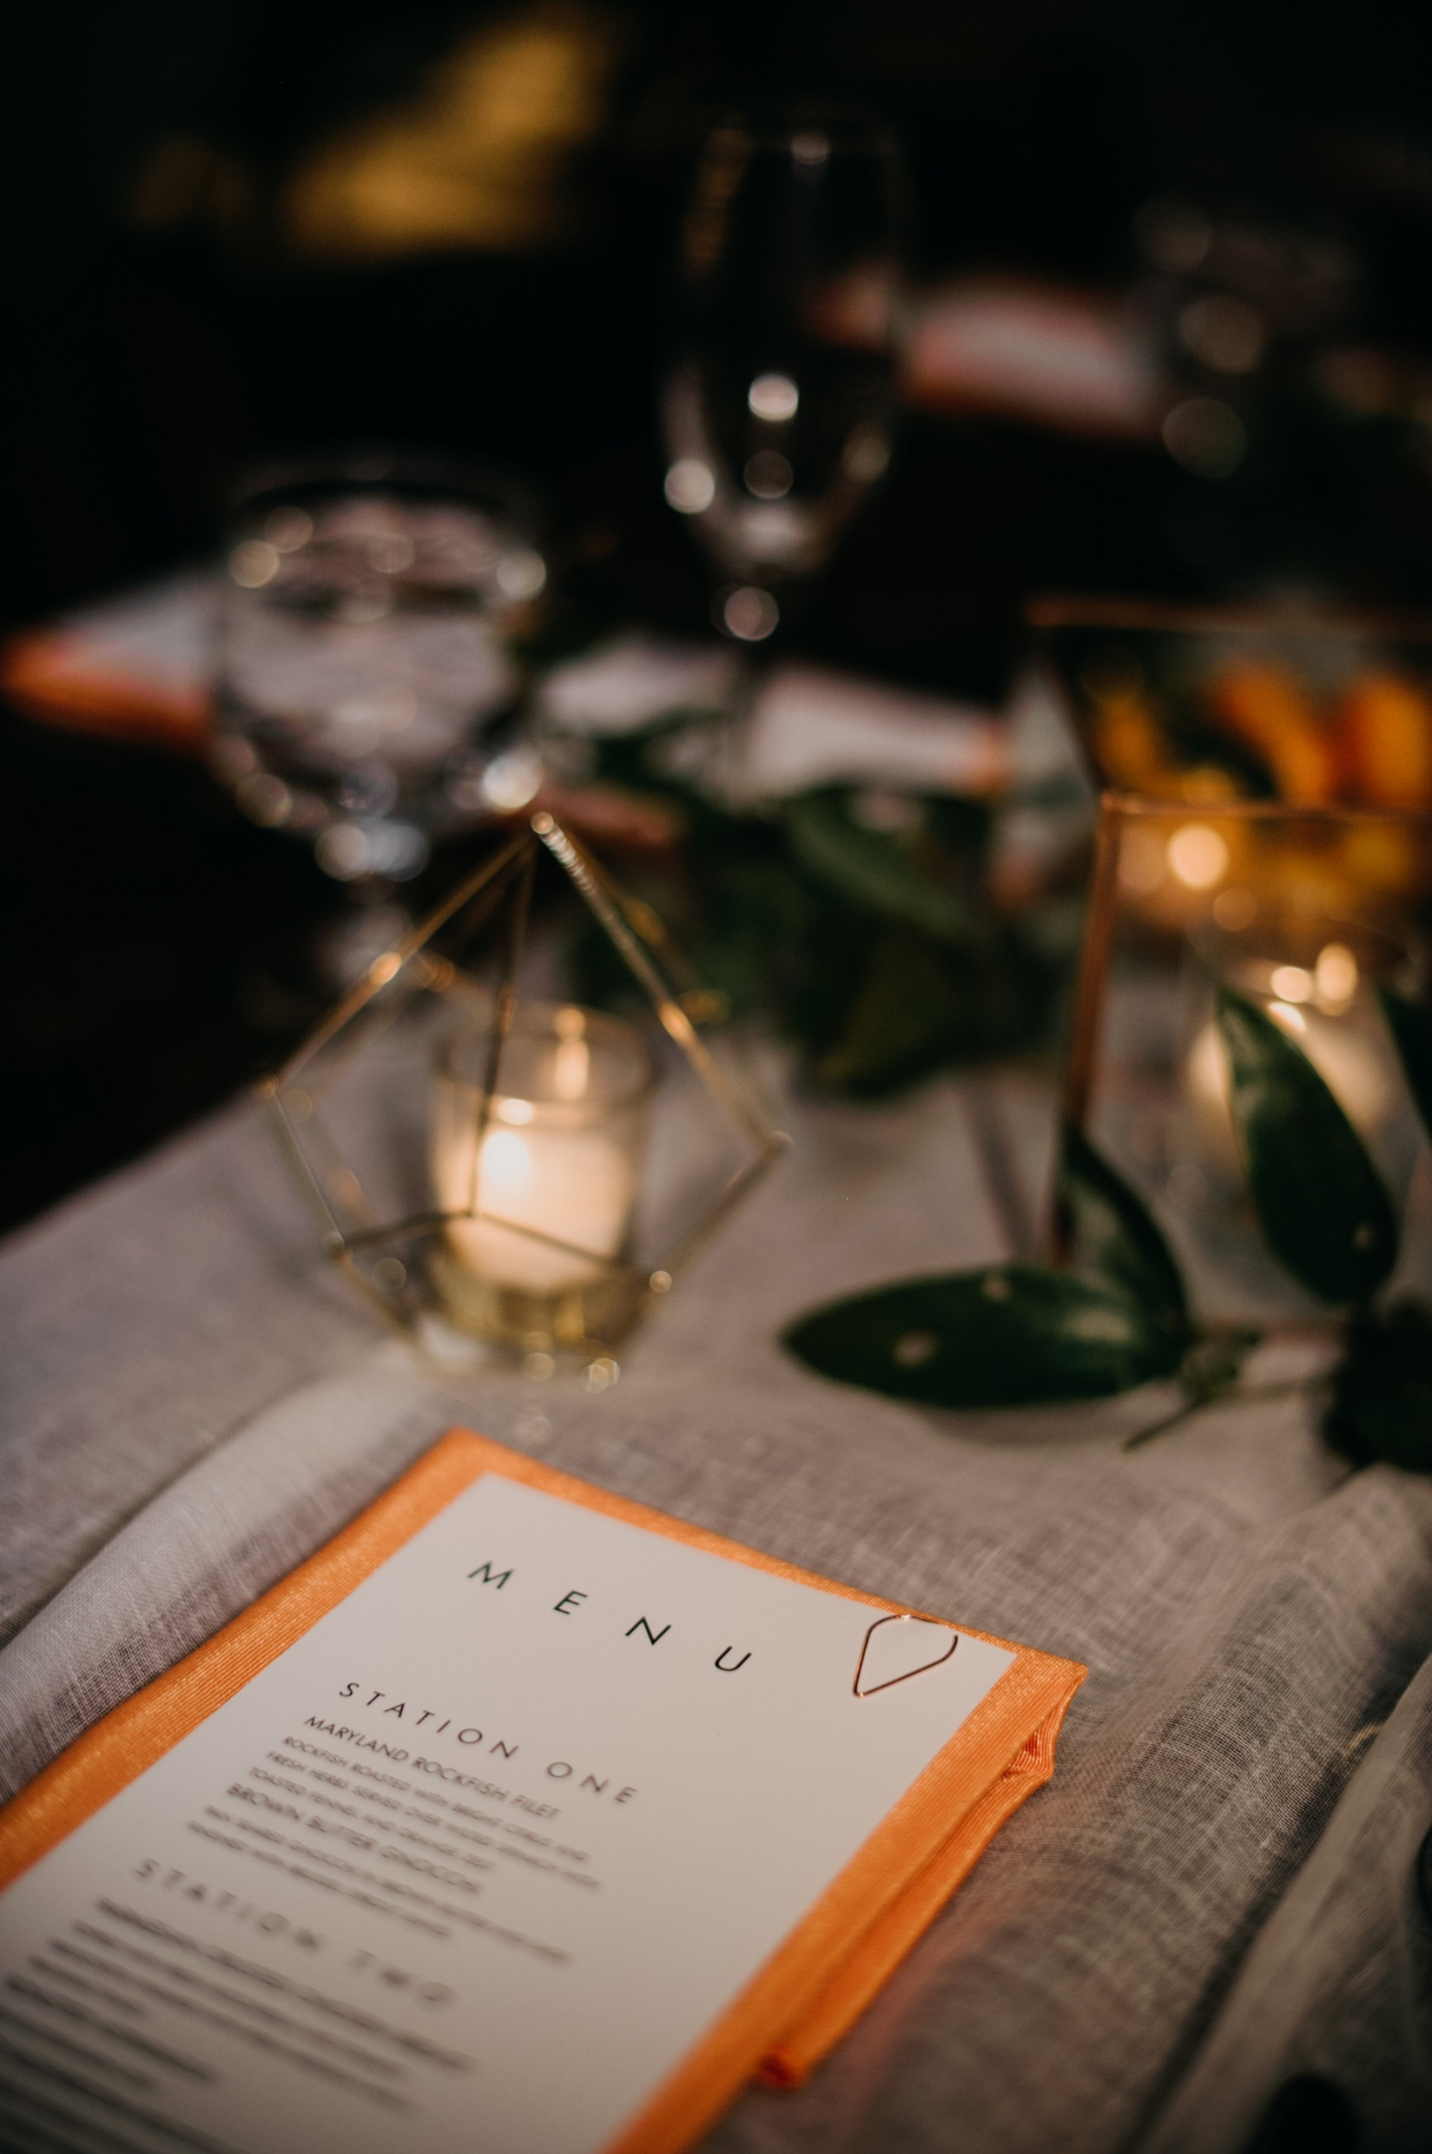
Approved Caterers
Atlantic Caterers Inc.
http://www.atlanticcaterers.com/
Raoul Frevel Jr. (rfrevel@atlanticcaterers.com) 410-254-6662 ext 126
Beefalo Bob’s BBQ Catering
www.beefalobobs.com
Erica Richardson (erica@beefalobobs.com) 410-360-3500 x1
Blue Pit BBQ
www.bluepitbbq.com
Cara Bruce (bluepit@bluepitbbq.com) (443) 948-5590
Class Act Catering
https://www. http://www.classactcatering.net/
Jim Britton (classactcatering@Verizon.net) (443) 521-0200
The Classic Catering People
https://www.classiccatering.com/
Larry Frank (lfrank@classiccatering.com) (443) 829-7199
Copper Kitchen
http://copperkitchenmd.com/
Mary Tawney (tawney@copperkitchenmd.com) (410) 244-7152
Hoopla!
https://www.hooplacatering.com/
Dori Chait (hello@hooplacatering.com) (410) 456-9904
Linwoods Catering
http://www.linwoods.com/
Sherri Levin (http://www.linwoods.com/) (410)581-4920 x23
Rouge
https://www.rougecatering.com/
Celeste Bendetti (celeste@rougecatering.com) (410) 527-0007
Zeffert & Gold
https://zeffertandgold.com/
Matt Gold (matt@zeffertandgold.com) (443) 744-0739
www.theassemblyroombaltimore.com • photo by: Magnolia Street Photography

Slide 2
Approved Glatt Kosher Caterers
Hoffman & Co.
http://www.hoffmancaterers.com/
Adrienne (info@lovetocater.com) (410) 764-6100
Knish Shop
https://www.knishshop.com/
Mosi (knishshop@gmail.com) 410-484-5850
O’Fishel Kosher Caterers
http://ofishel.com/
Simcha (ofishelkosher@gmail.com) (443) 660-9132
*Events requiring Glatt Kosher catering may be subject to additional fees
www.theassemblyroombaltimore.com • photo by: Magnolia Street Photography

